Slide 1


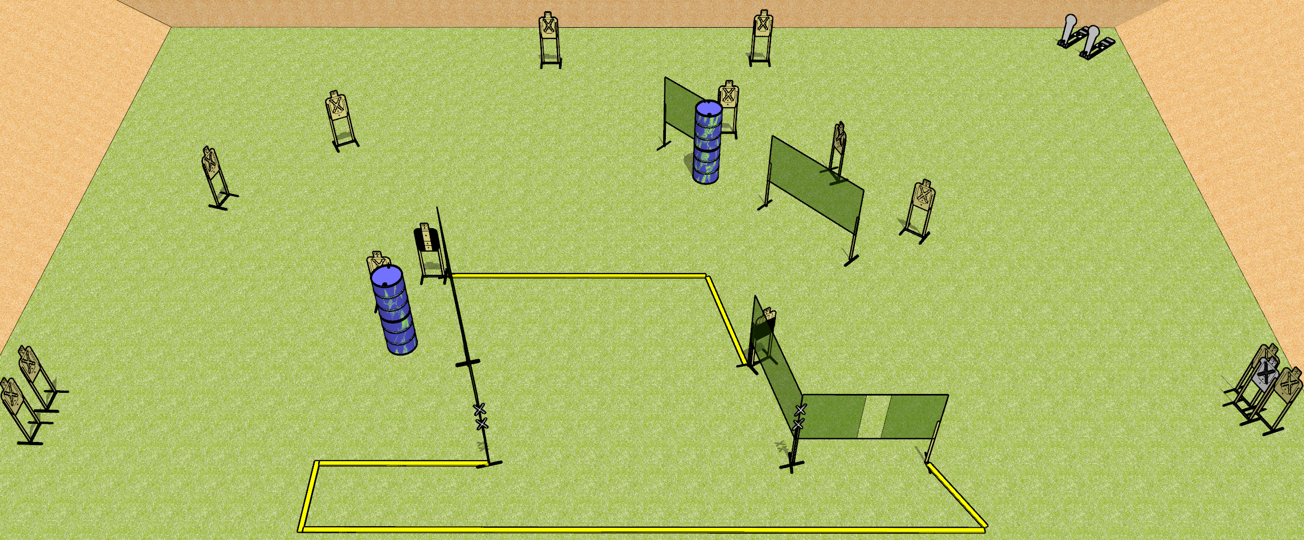
 | Dothan Gun Club – USPSA Match Touchy Touchy Course Designer : Drew Coleman
START POSITION : inside the shooting area with both hands touching either set of marks. PCC muzzle touching a mark.
GUN READY CONDITION : Pistol loaded and holstered. PCC loaded, held with both hands, shouldered, safety on, muzzle touching a mark |  | SCORING: Comstock, 30 rounds TARGETS: 14 paper, 2 Steel SCORED HITS: Best 2 on paper, steel until down START-STOP: Audible, last shot Notes: Marks are on the leftmost wall and the corner of the right two walls (reminder for setup in case the printout is hard to read)
STAGE PROCEDURE: Engage targets as they become available from within the fault lines.

Slide 2
Touchy Touchy
Written Stage Briefing
Touchy Touchy is a 30 round, 150 point, Comstock field course. There are fourteen USPSA targets and two Colt poppers. The best two hits on paper will score. The start signal is audible.
Handgun start position is inside the shooting area with both hands touching either set of marks. Handgun is loaded and holstered.
PCC start position is inside the shooting area with muzzle touching any mark. Loaded carbine is held with both hands, safety on.
On start signal, engage targets as they become available from within the shooting area.

